Slide 1
photoacoustic physical unclonable function for scalable and stretchable skin electronics

Slide 2
Contents
Section 1
Section 2
Section 3
Section 4
Section 5
Section 6

Slide 3
Fabrication Process
a
1% AgNW solution
AgNW network
CH₃
HO
O
H
UV exposure
Si
CH₃
n
PDMS
100°C
100°C
100°C
Glass/Dextran
500 rpm
1000 – 5000 rpm
PDMS substrate
PDMS curing
PDMS hydrophilization
AgNW solution coating
AgNW network formation
PDMS capping
Delamination

Slide 4
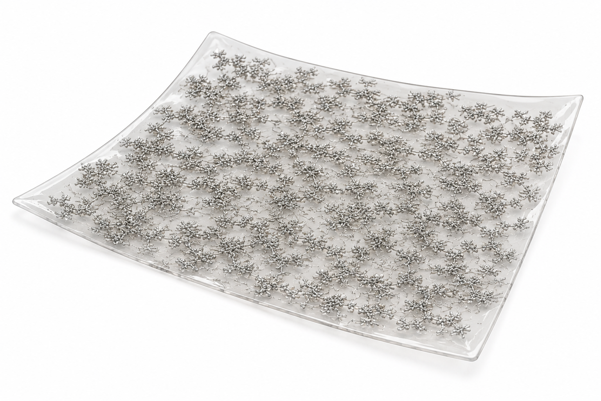
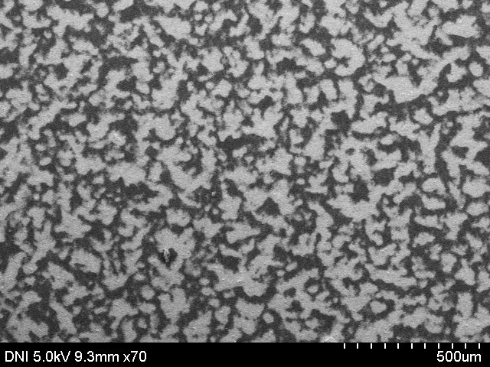
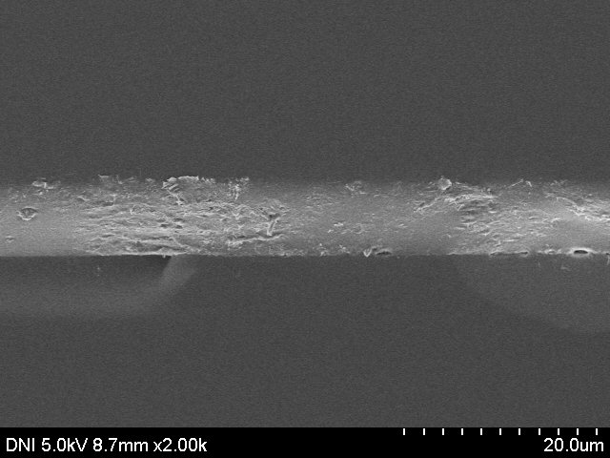
Top view
500 μm
PDMS
AgNW
Cross-section view
PDMS
10 μm

Slide 5
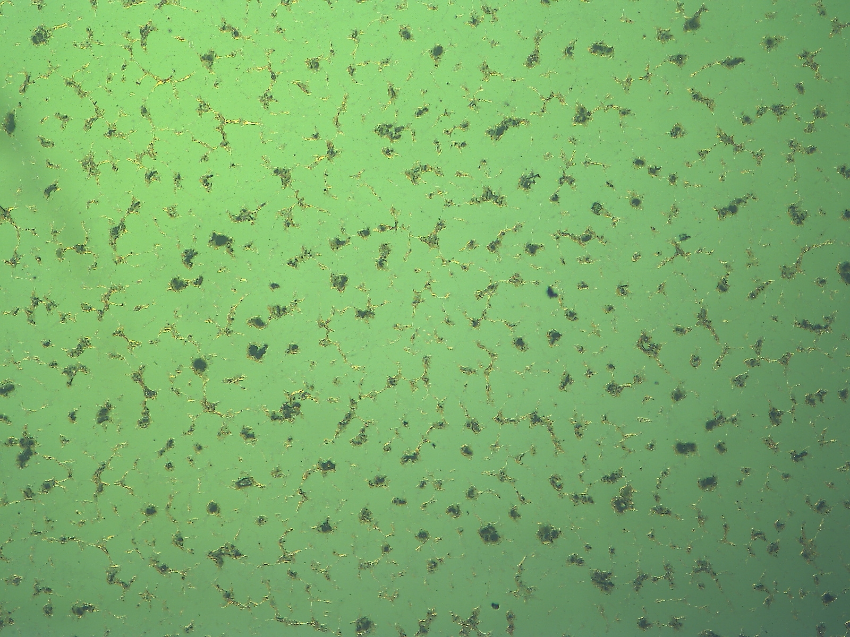
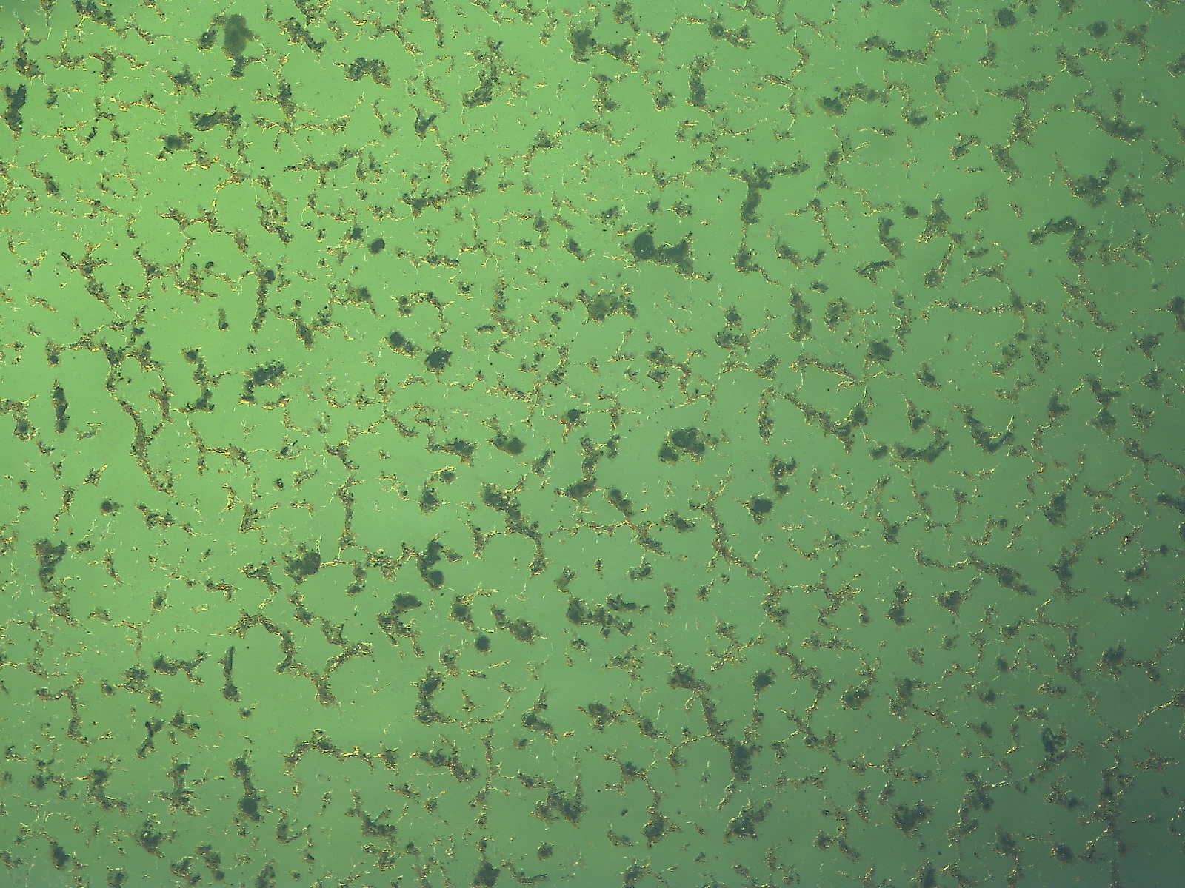
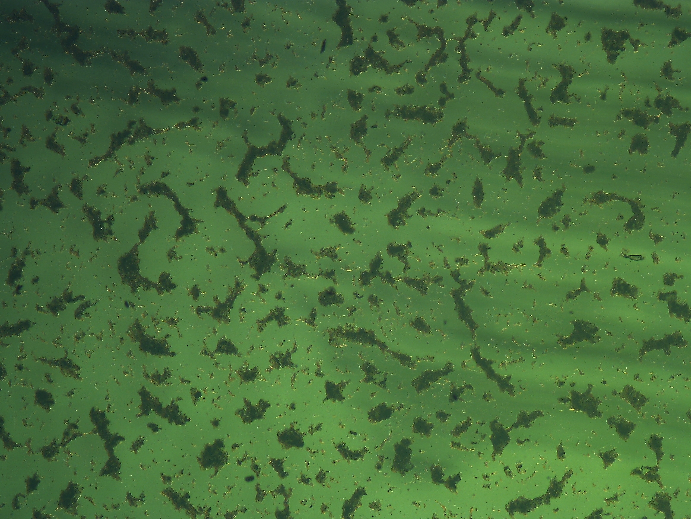
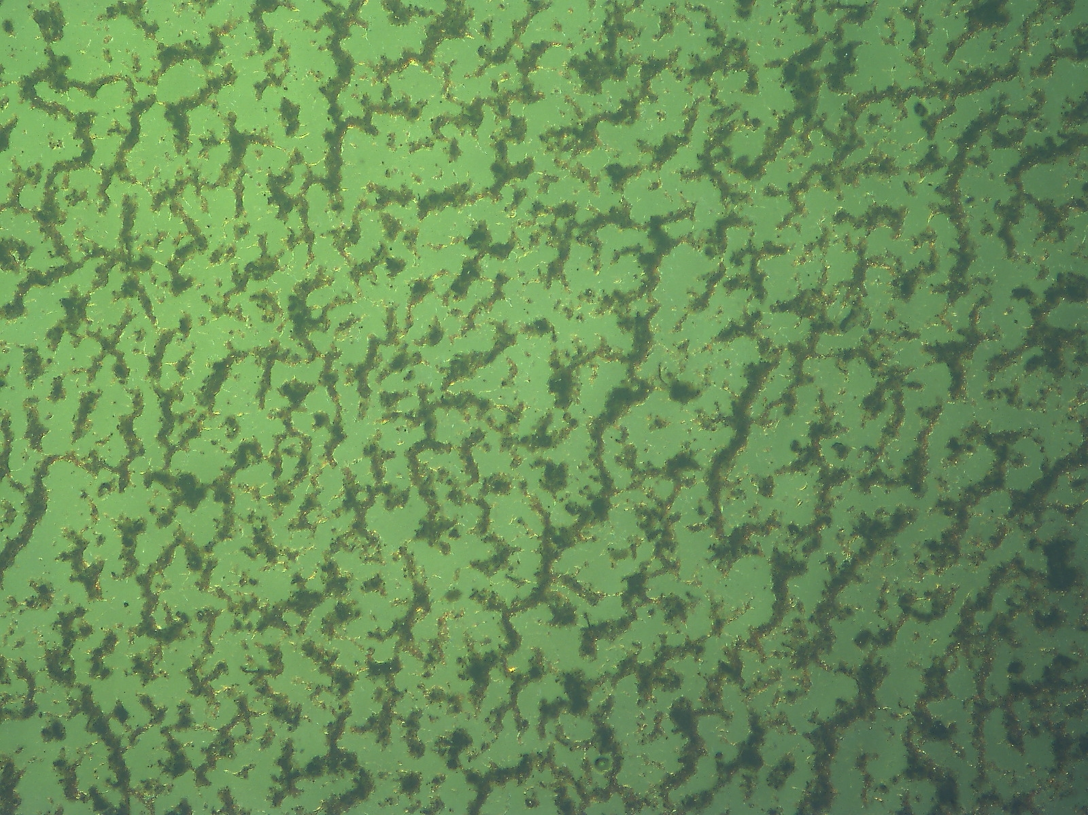
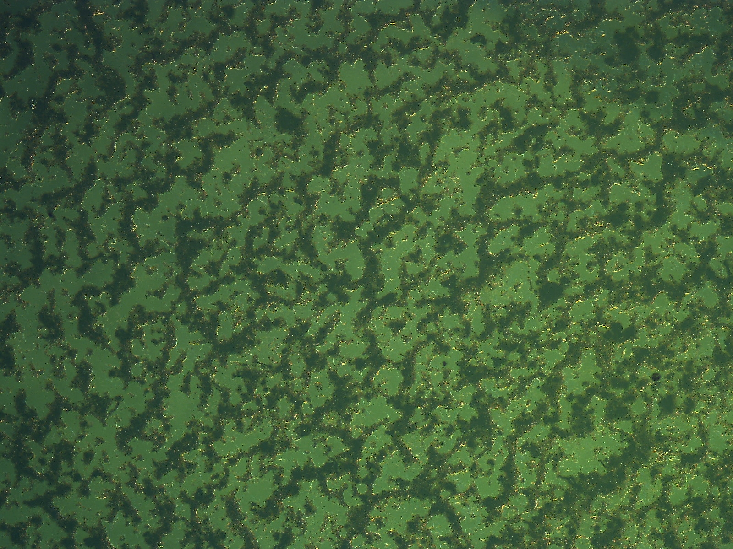
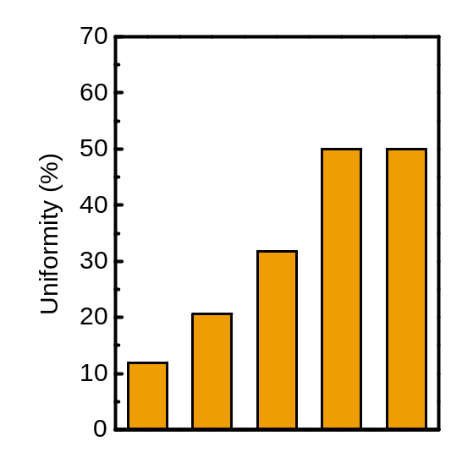
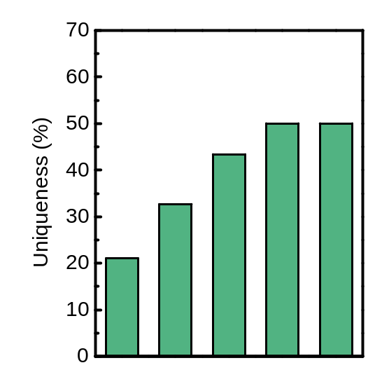
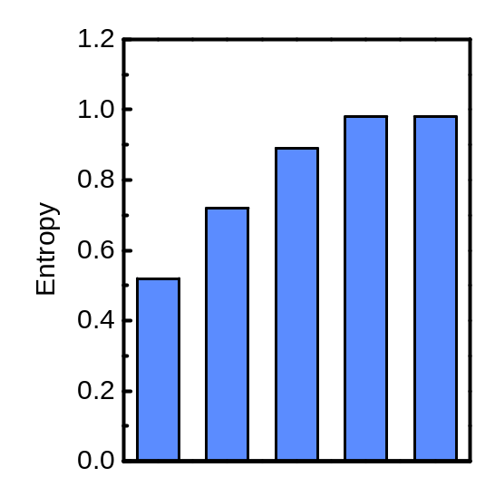
Spin coating cycle – PUF parameter
Spin X1
Spin X2
Spin X3
Spin X4
Spin X5
Uniformity | Uniqueness | Entropy
11.94 | 21.02 | 0.52
20.60 | 32.70 | 0.72
31.80 | 43.40 | 0.89
50.02 | 50.05 | 0.98
50.00 | 50.04 | 0.98

Slide 6
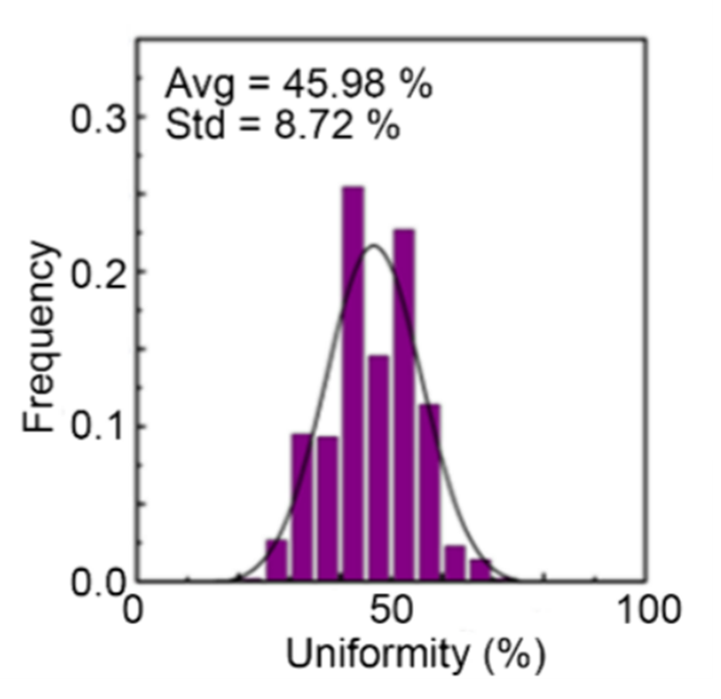
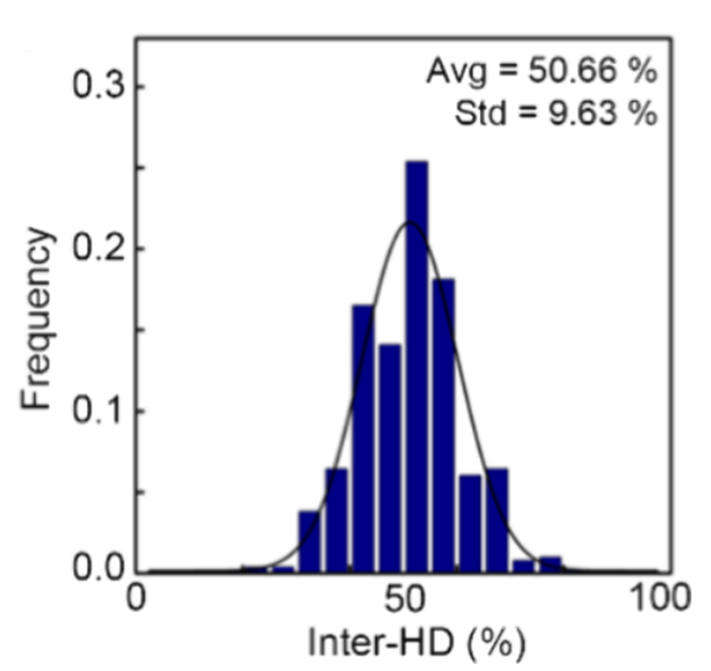
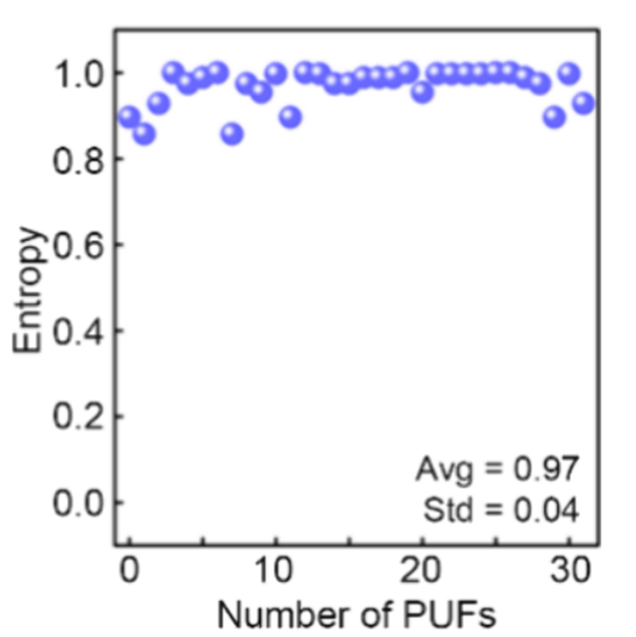
지표 설명
Chip a: 00110100
Uniformity: 3/8 = 37.5%
Chip a: 00110100
Chip b: 01110011
Hamming Distance: 4
Inter-HD: 4/8 = 50%
Chip a: 00001111
Chip b: 01010101
확률 분포가 얼마나 균일한가
최댓값: 50%
최댓값: 50%
최댓값: 1bit
10

Slide 7
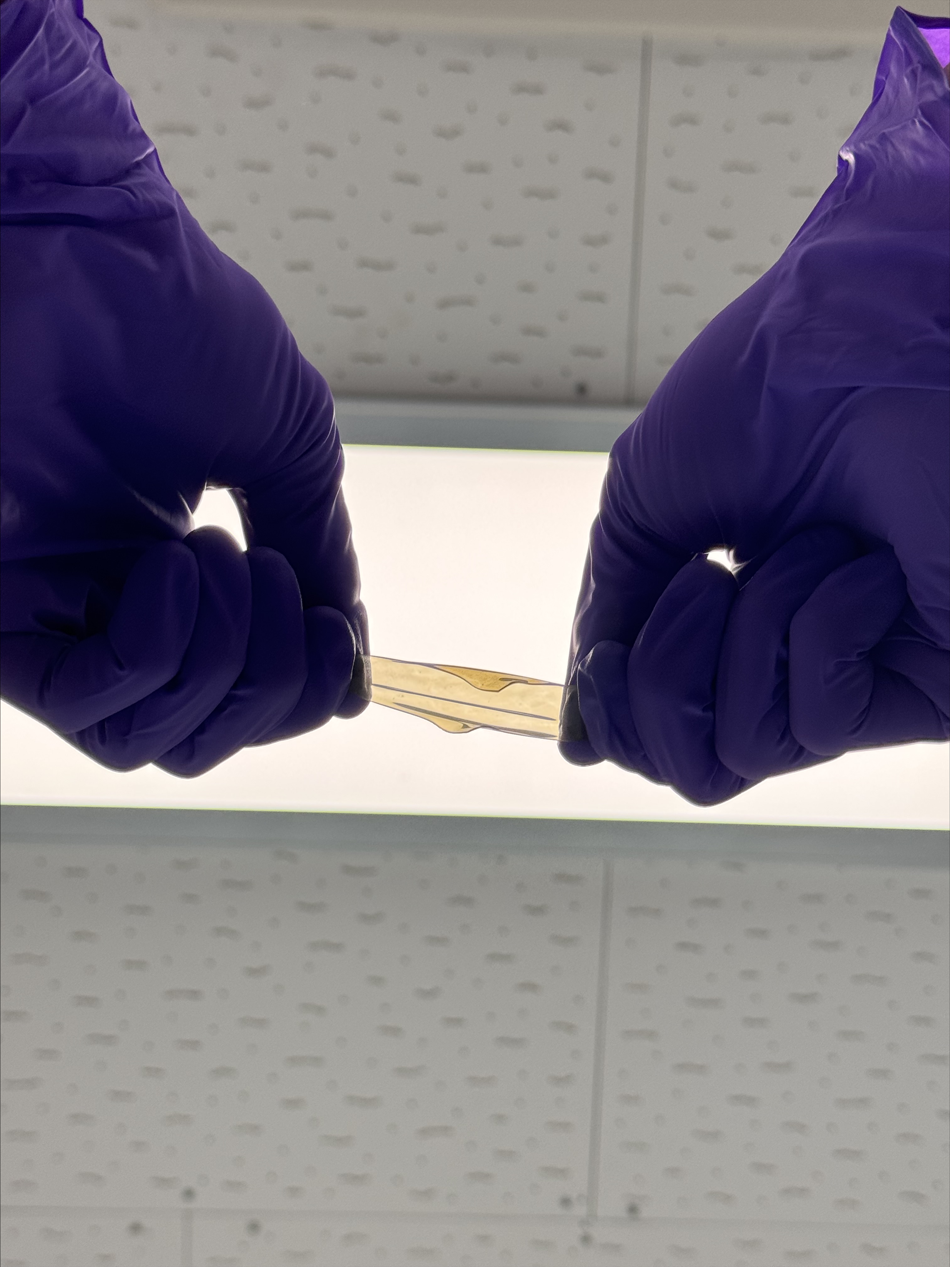
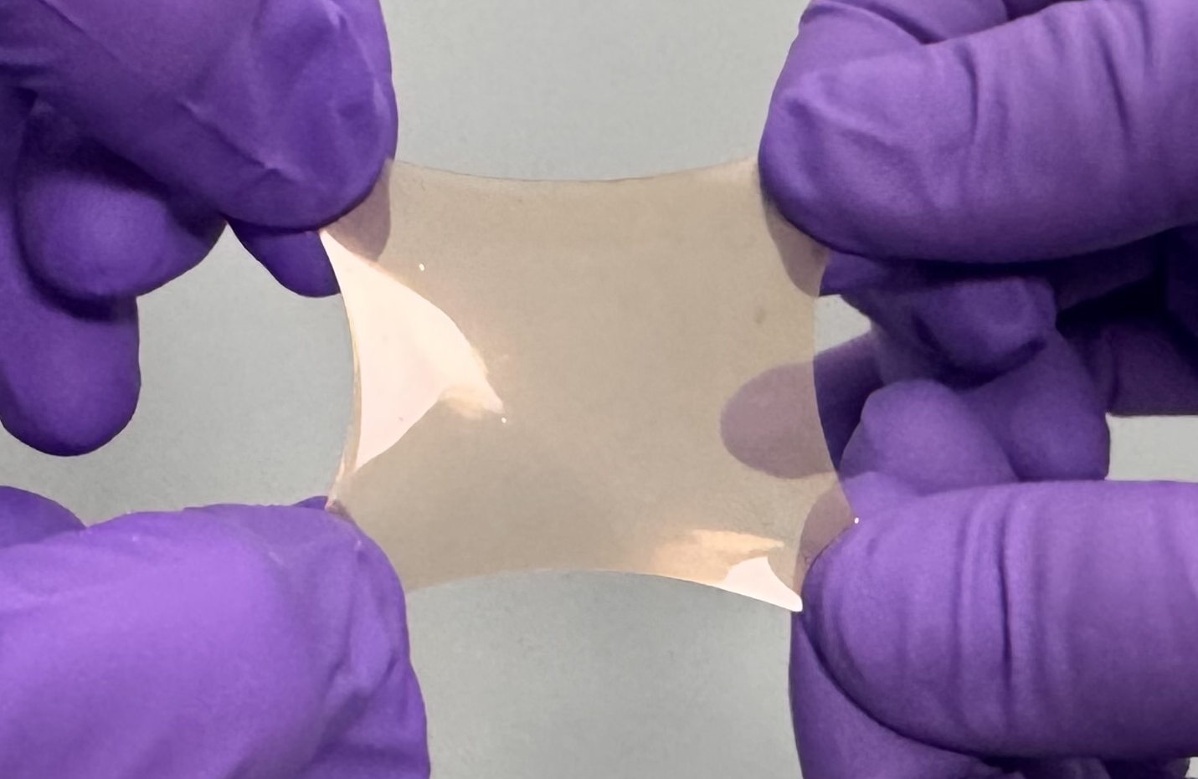
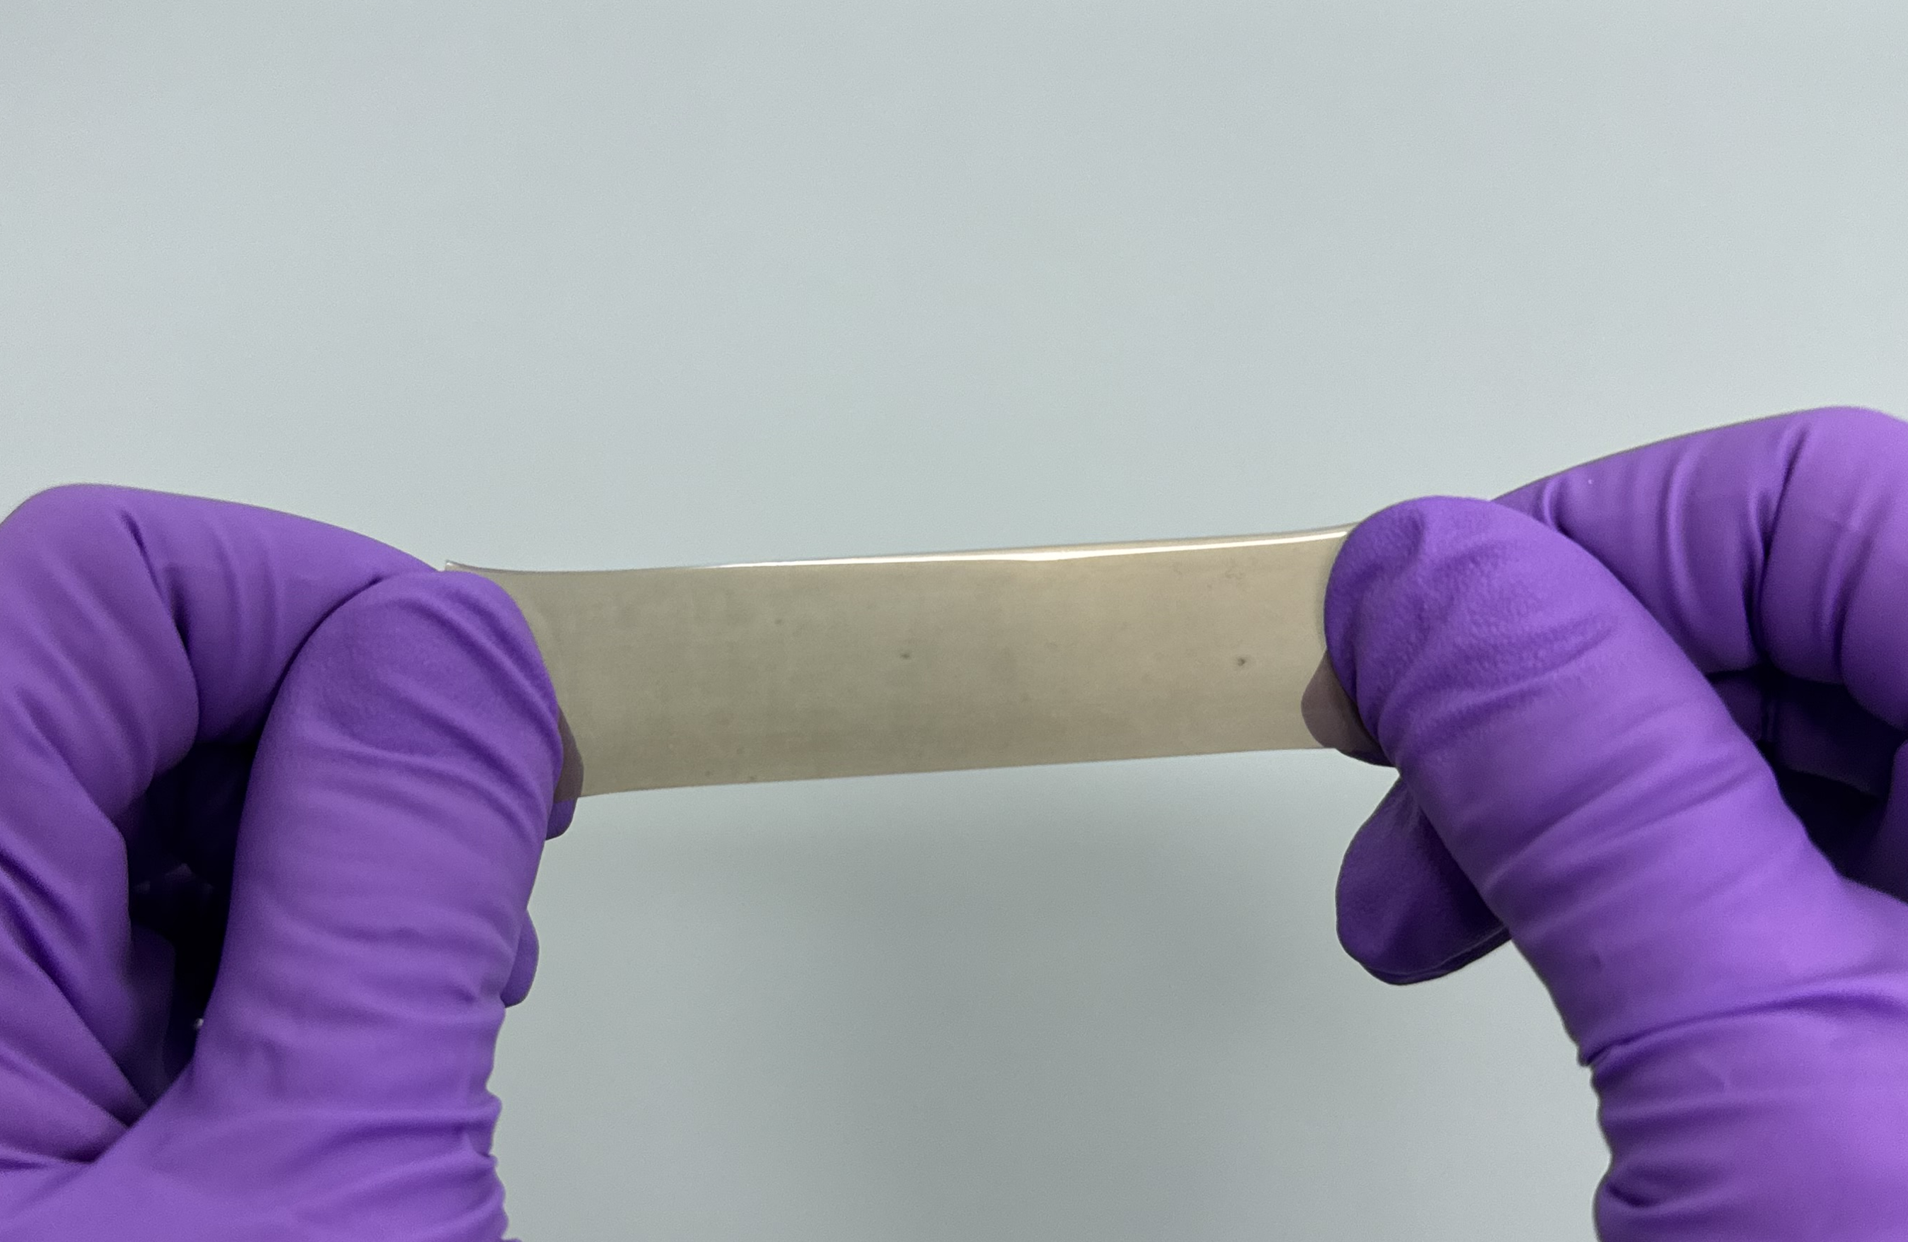
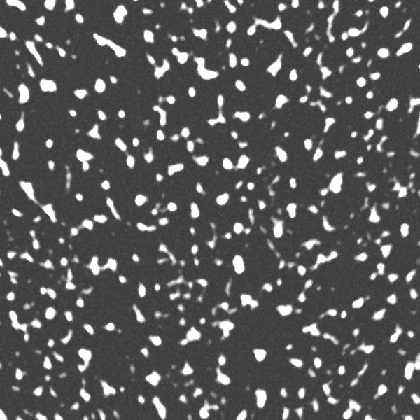
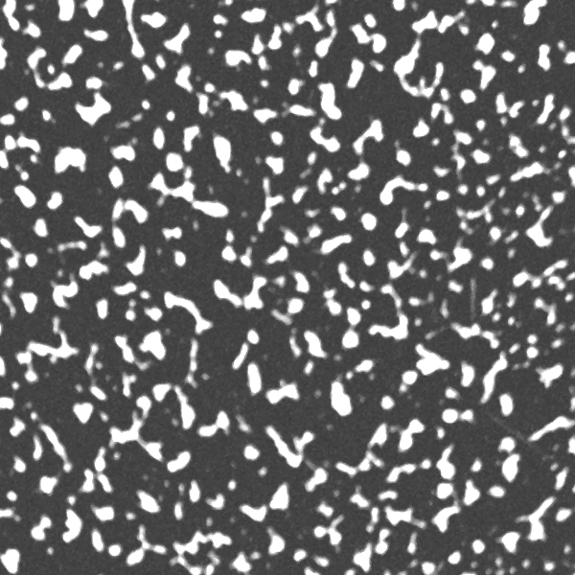
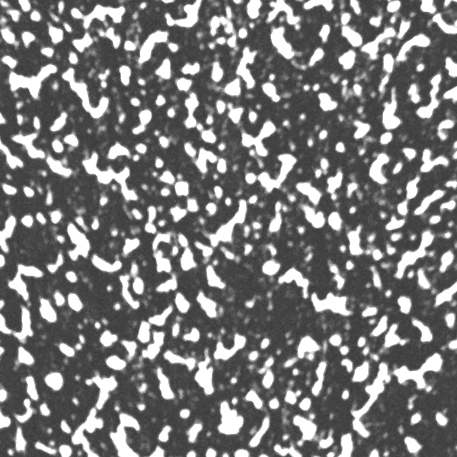
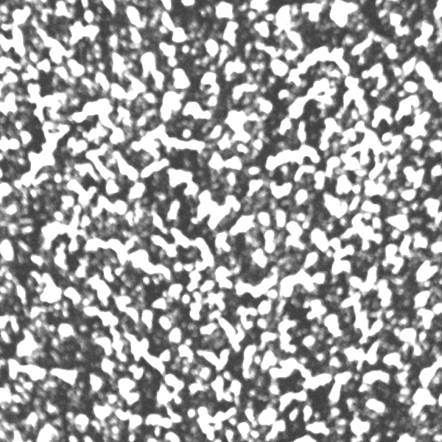
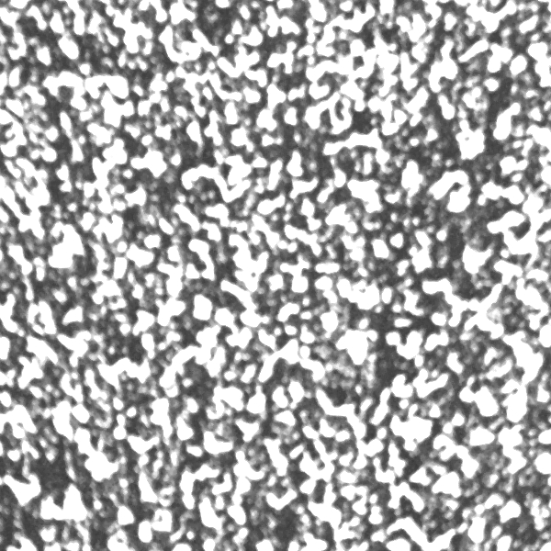
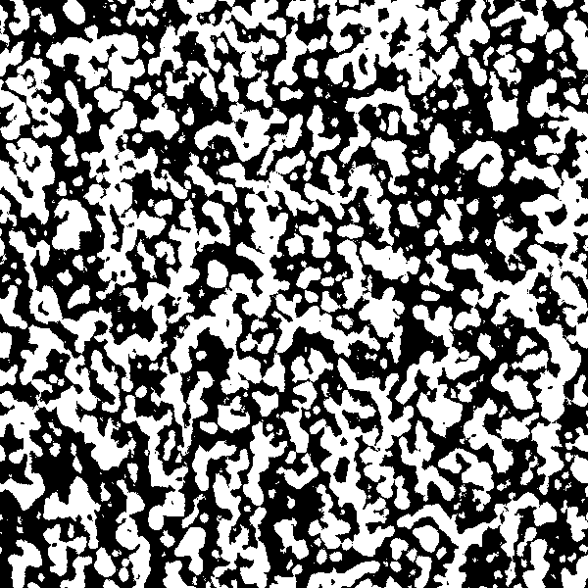
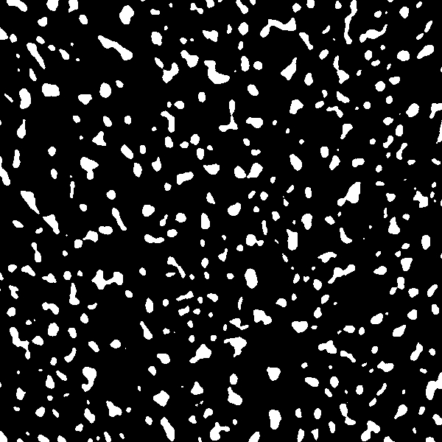
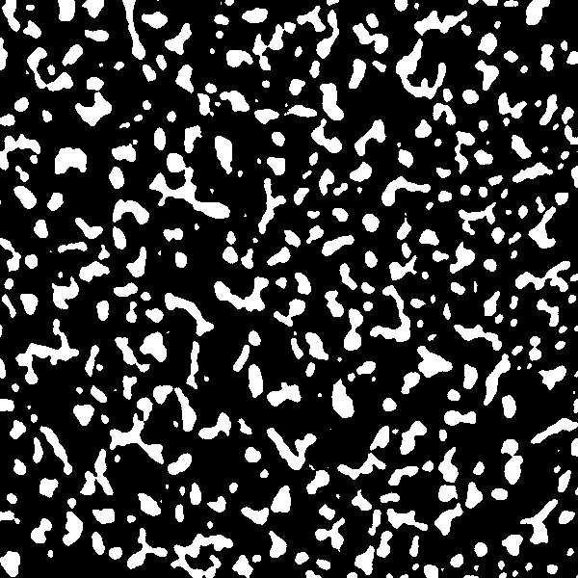
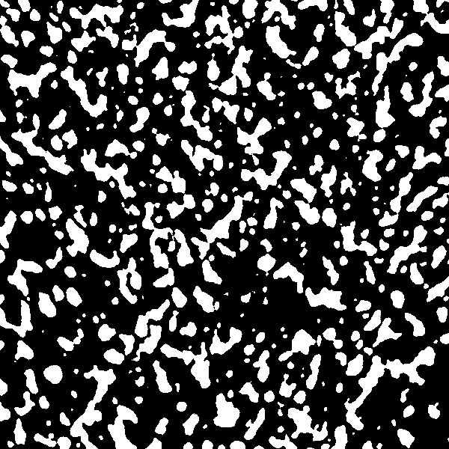
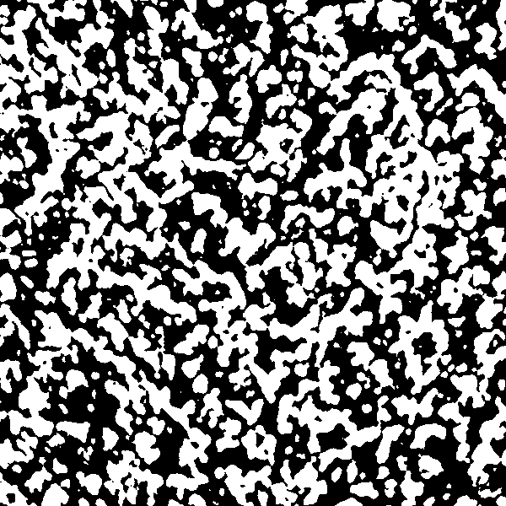
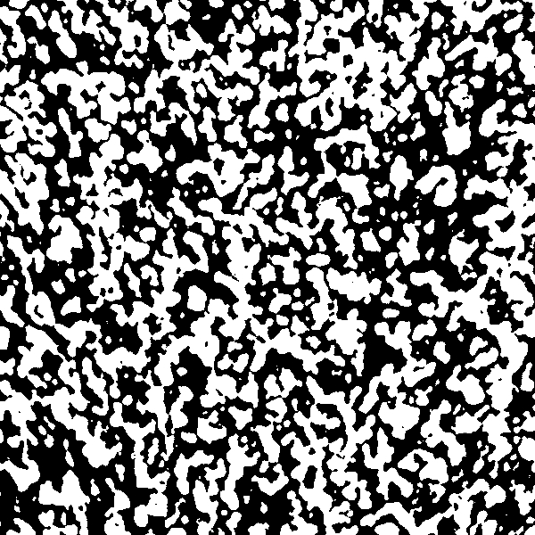
532 nm
SMF
C
C
Laser control
2 axis-
motor
Motor control
PA
OL
PC
GM
PM
Binary
Amp
PA signal
Galvo control
1
2
3
4
5
RUT
Coating cycle (#)
Sample

Slide 8

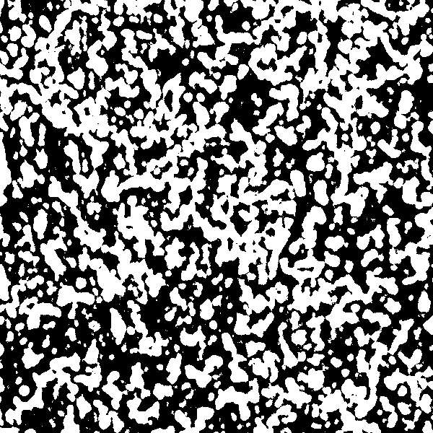
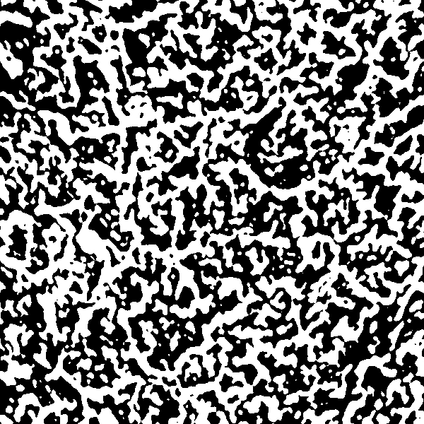
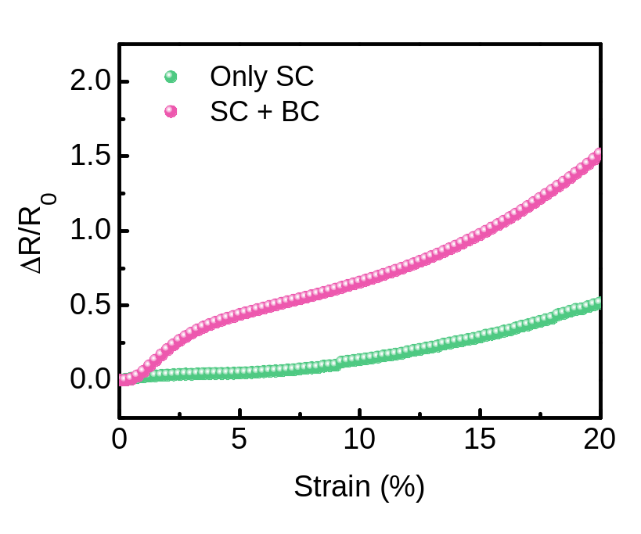
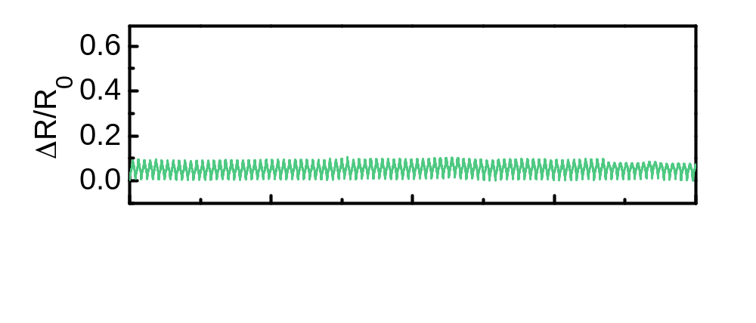
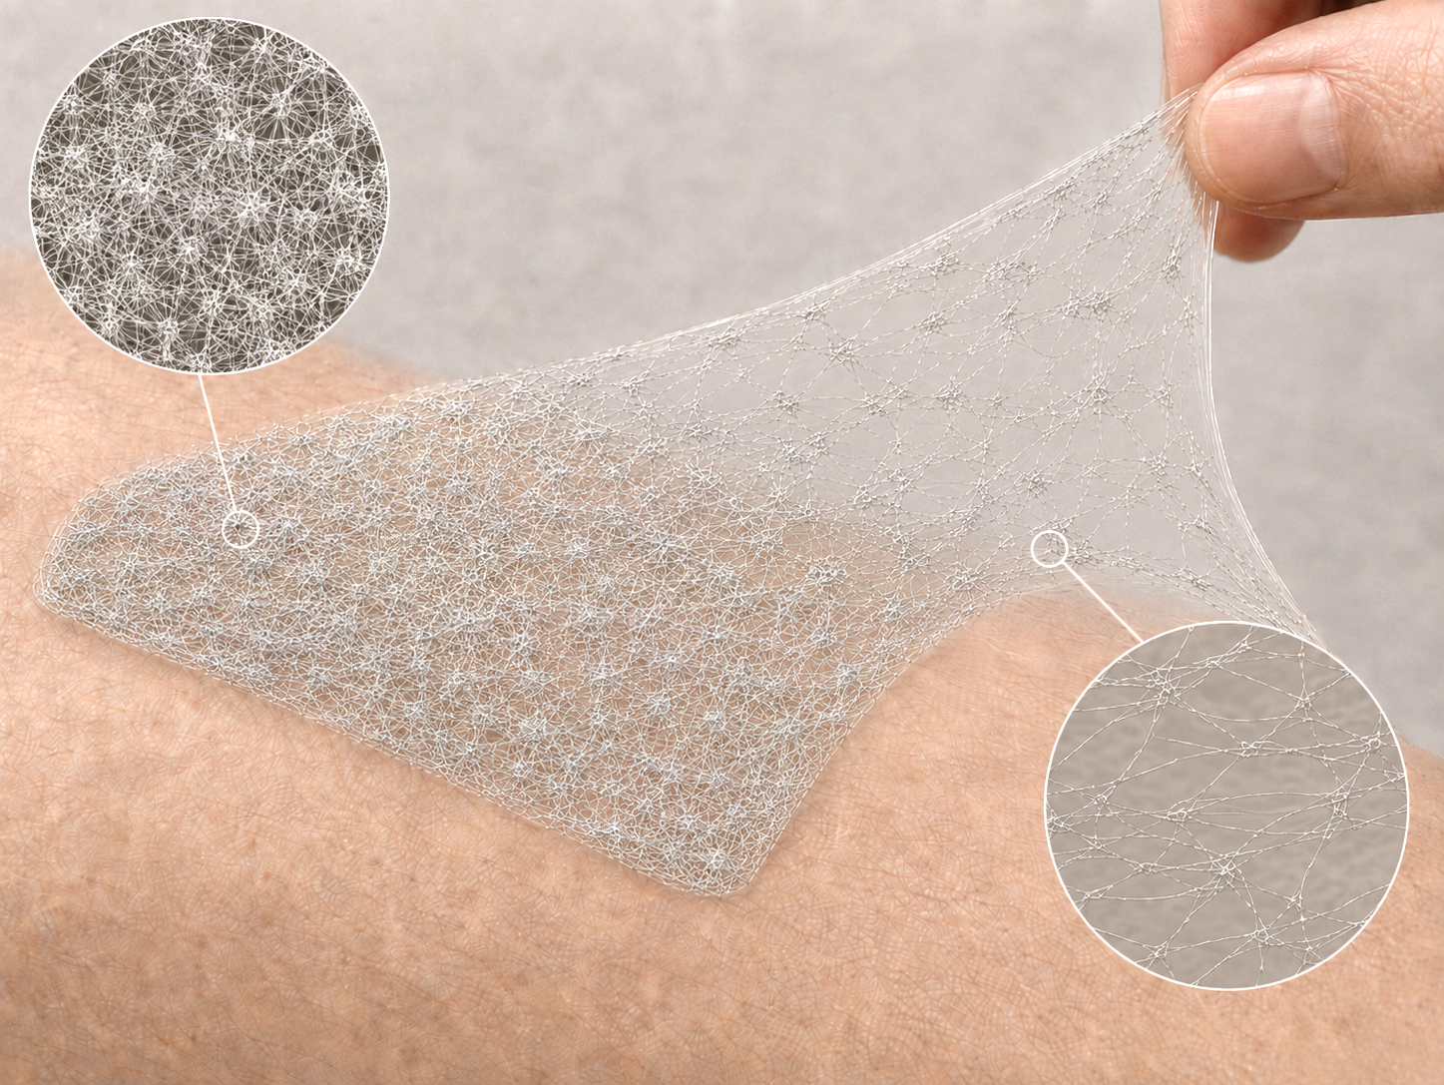
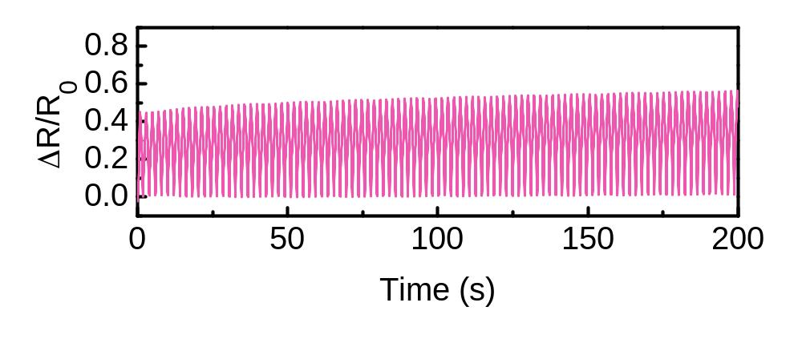
Only BC
Only SC
SC + BC
Blade coating
PDMS
PDMS
PDMS
Coating direction
←-----------
Substrate Temperature = 60°C
Only SC (10% Strain)
Dense AgNW
Physical attack
Physical attack
SC + BC (10% Strain)
Stretched AgNW

Slide 9

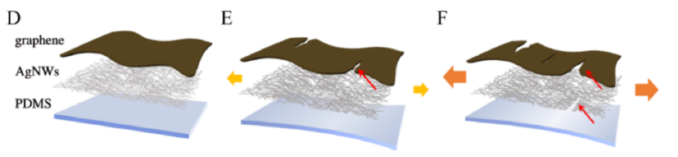
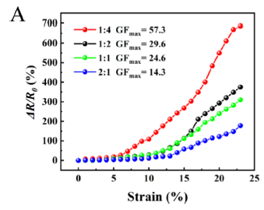
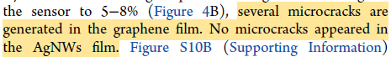
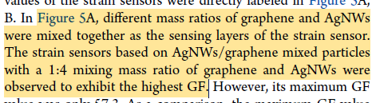
(D) 0% strain (E) 8% strain and (F) 10% strain
GF = (ΔR/R0) /strain
AgNWs : Graphene
1 : 4
1 : 2
1 : 1
2 : 1
GF_{max}
57.3
29.6
24.6
14.3
Figure 5. (A) Relative resistance changes strain curves of strain sensors based on AgNWs/
graphene mixed particles with different graphene and AgNWs mass ratios.

Slide 10
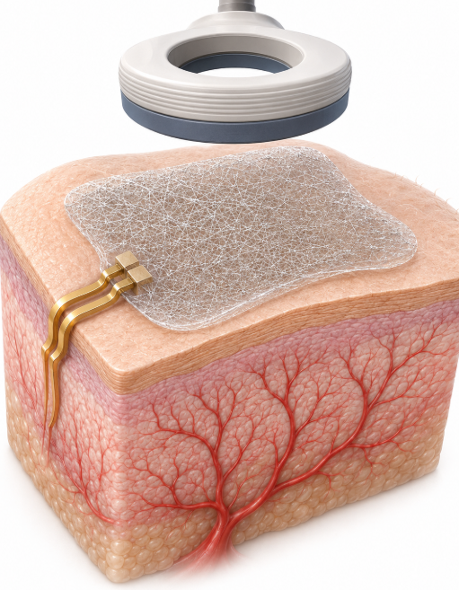
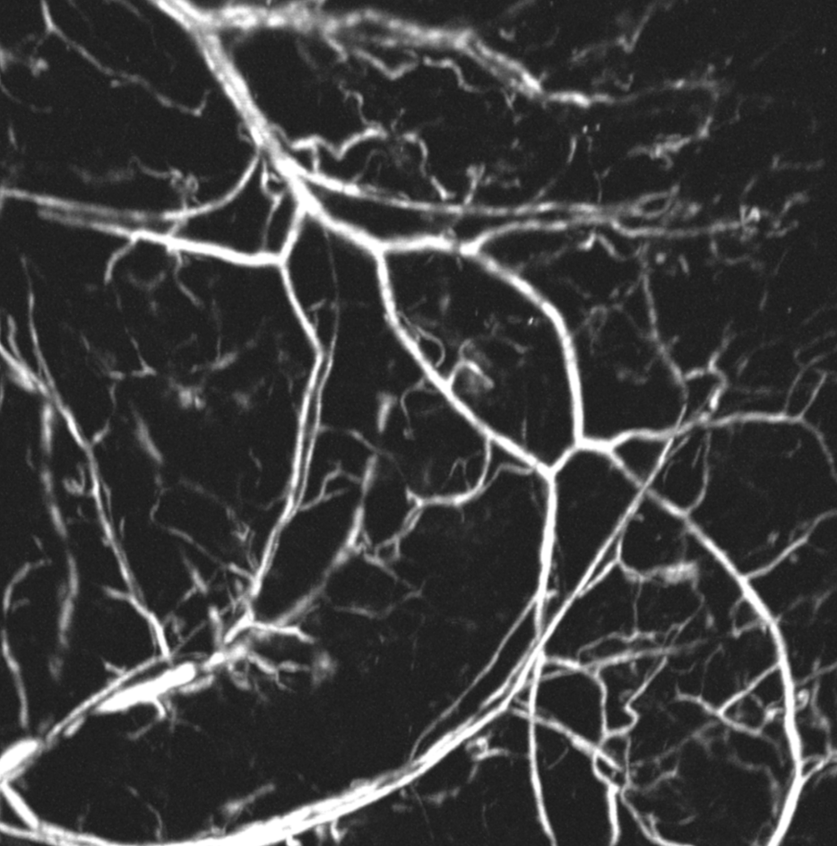

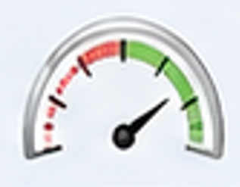


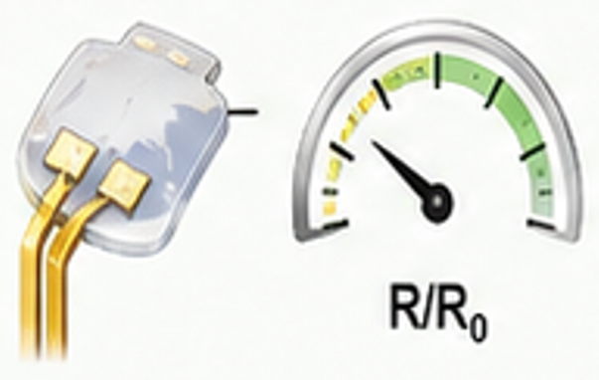
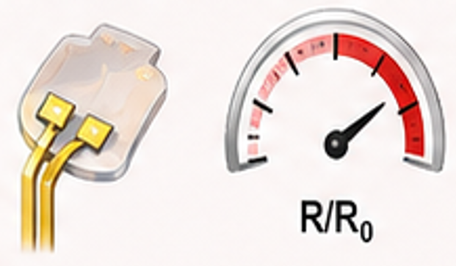

Application
Concept image
(example)
System decision workflow
PUF authorization
(initial state)
PUF key
check
Resistance
check
R/R0 <
threshold
(normal)
Bioinformation
access
Match
(R/R0 > threshold
ttack)
Bioinformation
blocked
save
Mismatch
c
d
e
Authorized state
Privacy-lock state
Unauthorized state
PUF 1
PUF key
PUF 1
PUF key
PUF 2
PUF key
101101...
101101...
000110...
PUF match
PUF match
PUF mismatch
Resistance
No
detection
Resistance
Attack detection
Resistance
No
detection
Func
#1
(PUF)
R/R0 <
threshold
R/R0 > threshold
R/R0 <
threshold
Func
#2
(resist)
Func
#3
(bioinfo)
Bioinformation
access
Bioinformation
blocked
Bioinformation
blocked

Slide 11
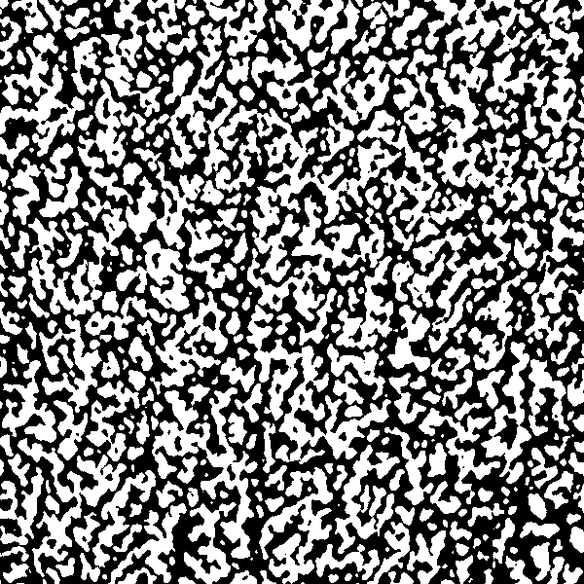
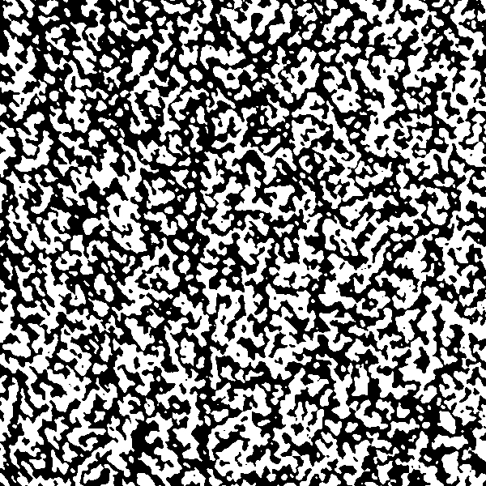
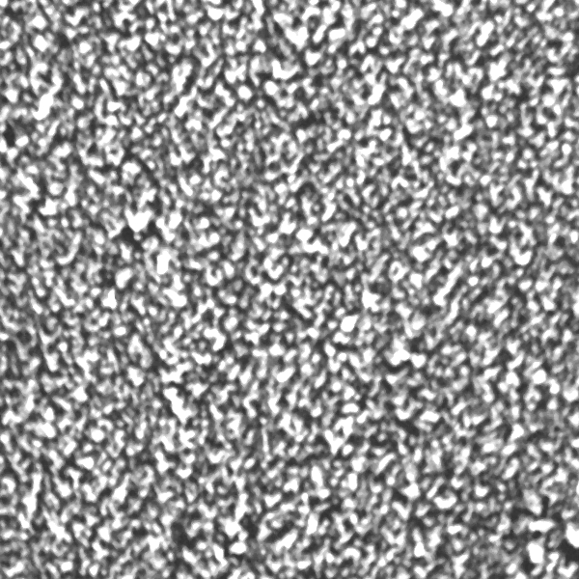
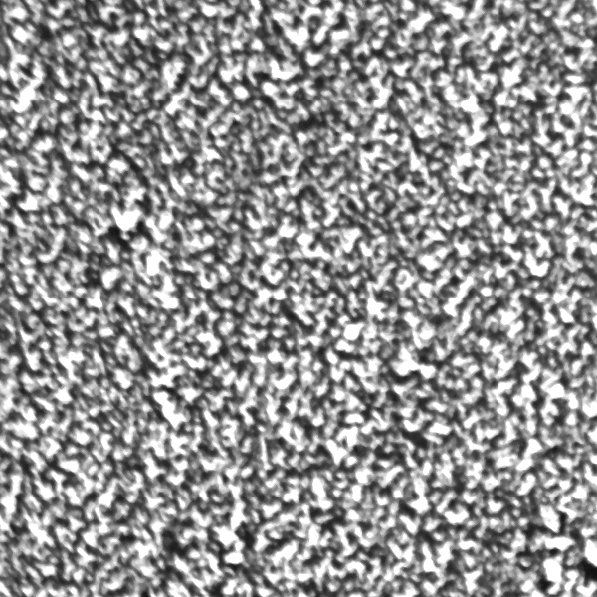
Before/After PDMS capping
Before
After

Slide 12
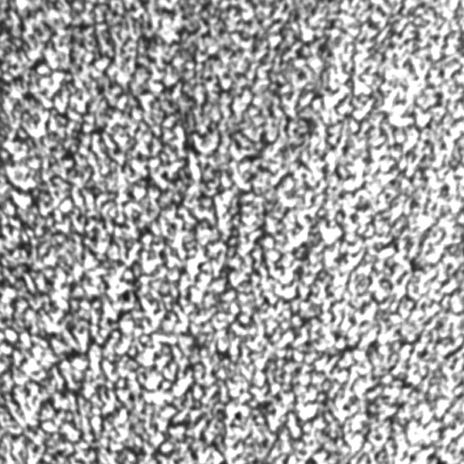
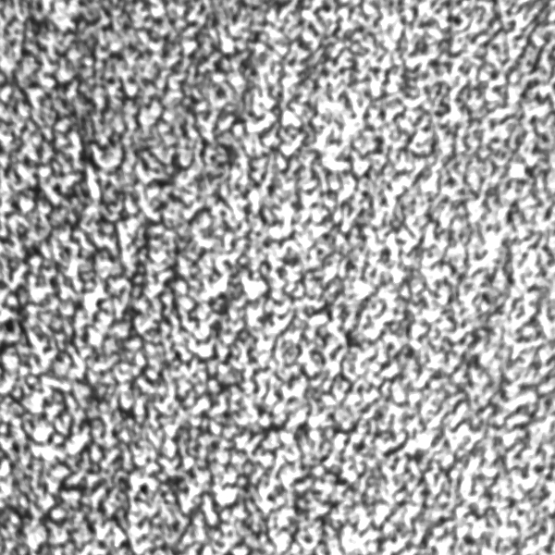
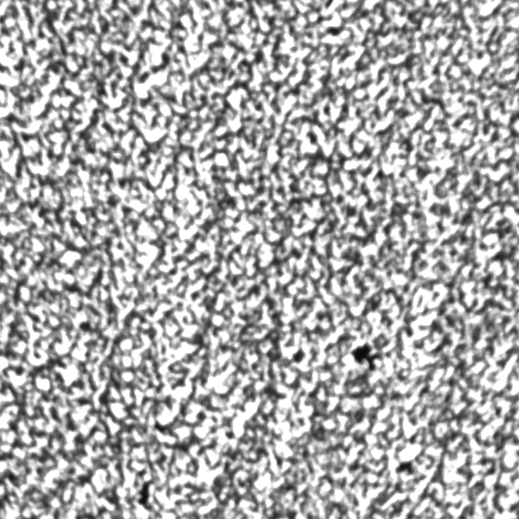

















Random 10 of PUF

Slide 13




Photoacoustic
microscopy
Mouse ear
Blood vessels on mouse ear

